Slide 1
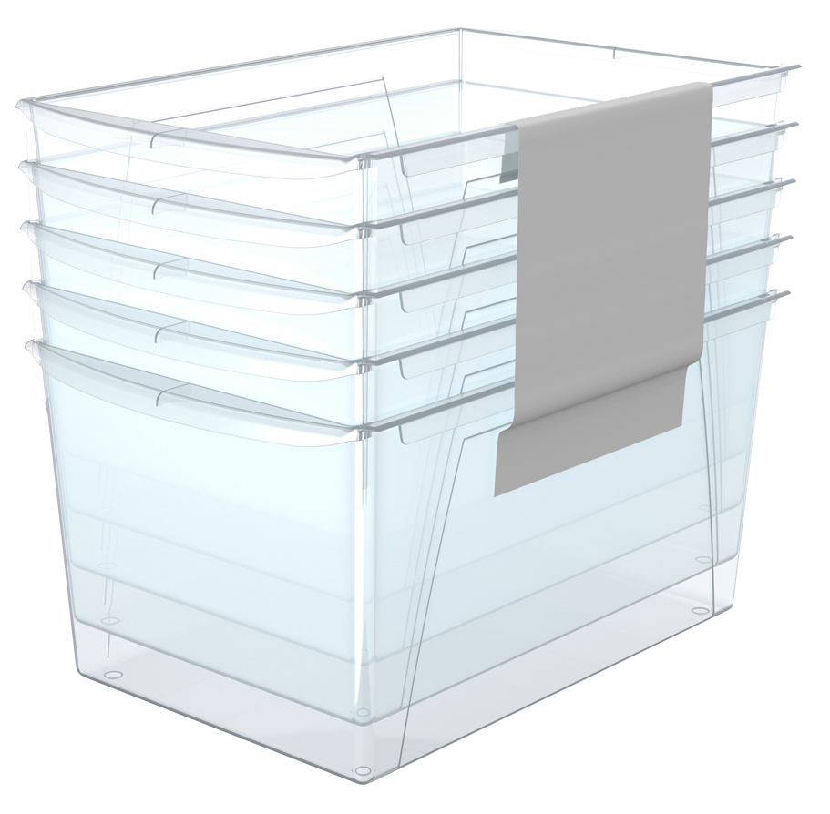
Interlocking Shelf Bins – Clear – 5 Pack
SAM’S EXCLUSIVE
Features: | DI Cost: | $8.54
Fits 15" deep shelves and desktops Turn them sideways to fit in 12" bookcases | Suggested Retail: | $12.99
Fit scrapbook paper, letter sized files and folder, and magazines | Margin: | 33%
Interior depth is 14" Integrated carry handles | Value To Market: | $34.99
Link several bins together | Savings: | 63%
Why Buy:
Refresh the current assortment
Research:
Clear is trending upward vs fashion colors
Notes:
8 weeks: July through August
TOTAL: $1.4Mk +125% , next year +30% = $1.82M NEXT YEAR
HOW: Improved front load to prevent OOS, MM PR/marketing, dedicated pallet placement (WITH execution?), improved quality story, less clutter with 4 designs vs 8 LY
LY landed cost: $12.30
Zippers- working with a new supplier to improve the quality without increasing cost.
Inside: lining shredding/cracking- Changing to a non-woven to avoid this in future. Increasing testing prior to avoid.
Straps ripping: Review strap strength and added X stitching below the triangle piece (below) to add additional strength.
Handle/Top – increased load test requirements and handle strength to exceed 95.77ibf

Slide 2
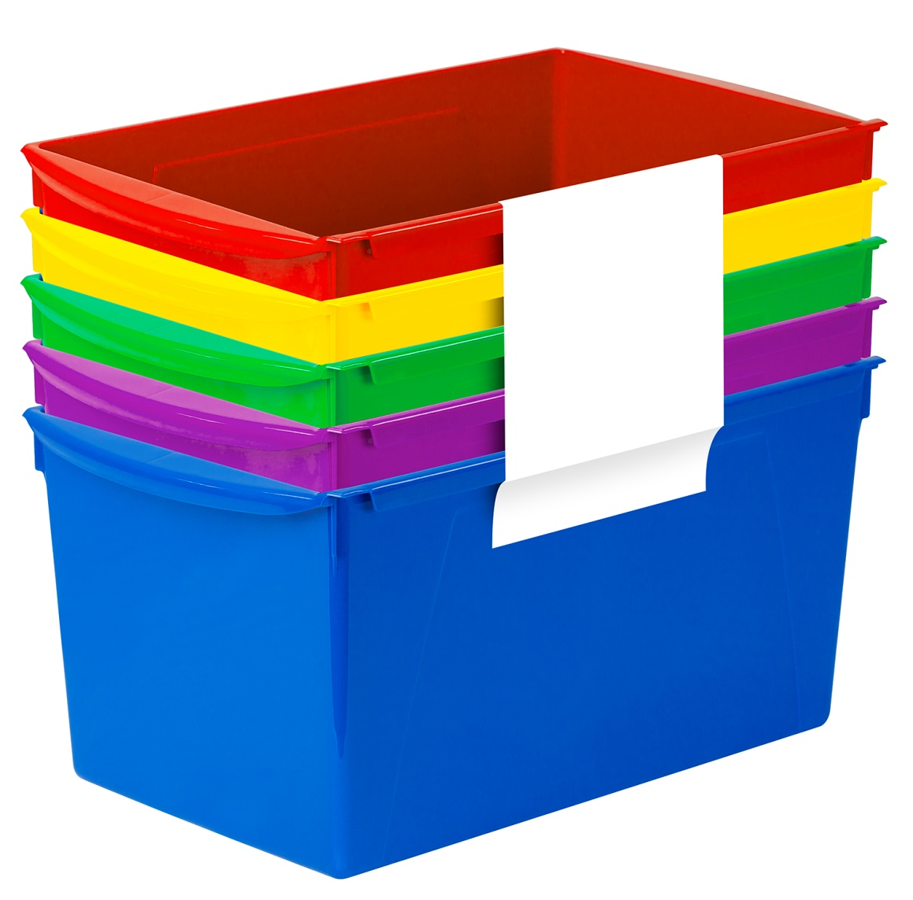
Interlocking Shelf Bins – Assorted – 5 Pack
SAM’S EXCLUSIVE
Features: | DI Cost: | $8.74
Fits 15" deep shelves and desktops Turn them sideways to fit in 12" bookcases | Suggested Retail: | $12.99
Fit scrapbook paper, letter sized files and folder, and magazines | Margin: | 33%
Interior depth is 14" Integrated carry handles | Value To Market: | $34.99
Link several bins together | Savings: | 63%
Why Buy:
New reduced cost Pass along savings to increase sales
Research:
STEM color palettes are evergreen whereas fashion colors follow current trends
Notes:
8 weeks: July through August
TOTAL: $1.4Mk +125% , next year +30% = $1.82M NEXT YEAR
HOW: Improved front load to prevent OOS, MM PR/marketing, dedicated pallet placement (WITH execution?), improved quality story, less clutter with 4 designs vs 8 LY
LY landed cost: $12.30
Zippers- working with a new supplier to improve the quality without increasing cost.
Inside: lining shredding/cracking- Changing to a non-woven to avoid this in future. Increasing testing prior to avoid.
Straps ripping: Review strap strength and added X stitching below the triangle piece (below) to add additional strength.
Handle/Top – increased load test requirements and handle strength to exceed 95.77ibf

Slide 3
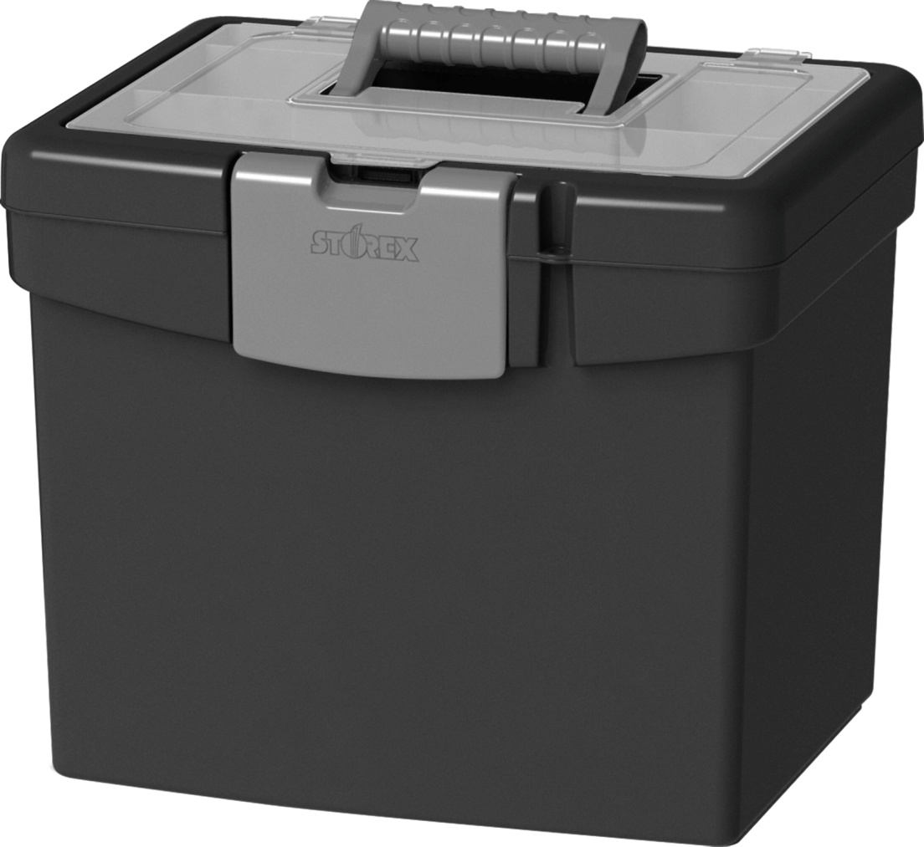
File Box - Black
SAM’S EXCLUSIVE
Features: | DI Cost: | $5.46
Holds letter sized hanging file folders Extra Large compartment in lid | Suggested Retail: | $8.99
Impact resistant Plastic Holds up to 4.6 us gallons | Margin: | 39%
Includes an easy grip handle for portable filing on the go | Value To Market: | $11.98
 | Savings: | 25%
Why Buy:
Core office essential Proven bestseller
Research:
Bestseller on Amazon & among office wholesalers Remote work has significantly increased demand for portable filing solutions
Notes:
8 weeks: July through August
TOTAL: $1.4Mk +125% , next year +30% = $1.82M NEXT YEAR
HOW: Improved front load to prevent OOS, MM PR/marketing, dedicated pallet placement (WITH execution?), improved quality story, less clutter with 4 designs vs 8 LY
LY landed cost: $12.30
Zippers- working with a new supplier to improve the quality without increasing cost.
Inside: lining shredding/cracking- Changing to a non-woven to avoid this in future. Increasing testing prior to avoid.
Straps ripping: Review strap strength and added X stitching below the triangle piece (below) to add additional strength.
Handle/Top – increased load test requirements and handle strength to exceed 95.77ibf

Slide 4
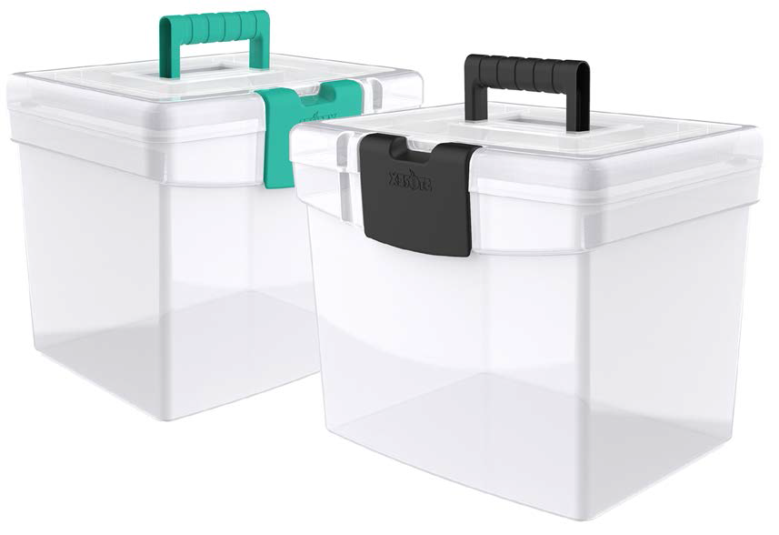
File Box - Clear
SAM’S EXCLUSIVE
Features: | DI Cost: | $5.70
Holds letter sized hanging file folders Extra Large compartment in lid | Suggested Retail: | $8.99
Impact resistant Plastic Holds up to 4.6 us gallons | Margin: | 37%
Includes an easy grip handle for portable filing on the go | Value To Market: | $11.98
 | Savings: | 25%
Why Buy:
Exclusive variant of a proven bestseller Cross sells with both office and craft stationary
Research:
Clear is trending upward in small/home office vs. fashion colors.
Notes:
8 weeks: July through August
TOTAL: $1.4Mk +125% , next year +30% = $1.82M NEXT YEAR
HOW: Improved front load to prevent OOS, MM PR/marketing, dedicated pallet placement (WITH execution?), improved quality story, less clutter with 4 designs vs 8 LY
LY landed cost: $12.30
Zippers- working with a new supplier to improve the quality without increasing cost.
Inside: lining shredding/cracking- Changing to a non-woven to avoid this in future. Increasing testing prior to avoid.
Straps ripping: Review strap strength and added X stitching below the triangle piece (below) to add additional strength.
Handle/Top – increased load test requirements and handle strength to exceed 95.77ibf

Slide 5
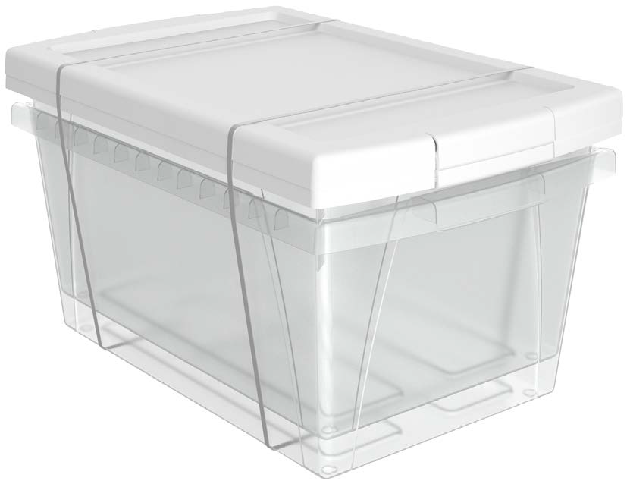
5.5 Gallon – Clear – 2 Pack
SAM’S EXCLUSIVE
Features: | DI Cost: | $10.72
Heavy Duty Made of sturdy, drop resistant plastic | Suggested Retail: | $15.99
Organize your supplies | Margin: | 33%
Front and rear handles for easy gripping, even with little hands | Value To Market: | $29.99
The inside of the bin is 14" long to hold legal and letter size papers and workbooks | Savings: | 47%
Why Buy:
Cross sell with legal paper (1 bin conveniently holds up to 4 reams)
Research:
Fluctuating resin prices indirectly created a market opportunity for small, heavy duty storage.
Notes:
8 weeks: July through August
TOTAL: $1.4Mk +125% , next year +30% = $1.82M NEXT YEAR
HOW: Improved front load to prevent OOS, MM PR/marketing, dedicated pallet placement (WITH execution?), improved quality story, less clutter with 4 designs vs 8 LY
LY landed cost: $12.30
Zippers- working with a new supplier to improve the quality without increasing cost.
Inside: lining shredding/cracking- Changing to a non-woven to avoid this in future. Increasing testing prior to avoid.
Straps ripping: Review strap strength and added X stitching below the triangle piece (below) to add additional strength.
Handle/Top – increased load test requirements and handle strength to exceed 95.77ibf

Slide 6
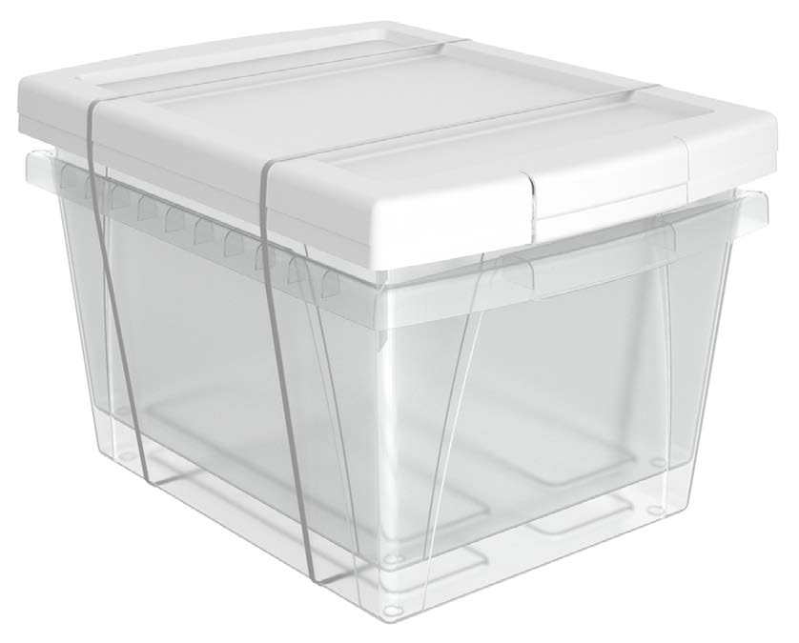
4 Gallon – Clear – 2 Pack
SAM’S EXCLUSIVE
Features: | DI Cost: | $8.29
Heavy Duty Made of sturdy, drop resistant plastic | Suggested Retail: | $12.99
Organize your supplies | Margin: | 36%
Front and rear handles for easy gripping, even with little hands | Value To Market: | $24.99
Includes clear lid | Savings: | 48%
Why Buy:
Cross sell with letter paper (1 bin conveniently holds up to 4 reams)
Research:
Fluctuating resin prices indirectly created a market opportunity for small, heavy duty storage.
Notes:
8 weeks: July through August
TOTAL: $1.4Mk +125% , next year +30% = $1.82M NEXT YEAR
HOW: Improved front load to prevent OOS, MM PR/marketing, dedicated pallet placement (WITH execution?), improved quality story, less clutter with 4 designs vs 8 LY
LY landed cost: $12.30
Zippers- working with a new supplier to improve the quality without increasing cost.
Inside: lining shredding/cracking- Changing to a non-woven to avoid this in future. Increasing testing prior to avoid.
Straps ripping: Review strap strength and added X stitching below the triangle piece (below) to add additional strength.
Handle/Top – increased load test requirements and handle strength to exceed 95.77ibf

Slide 7
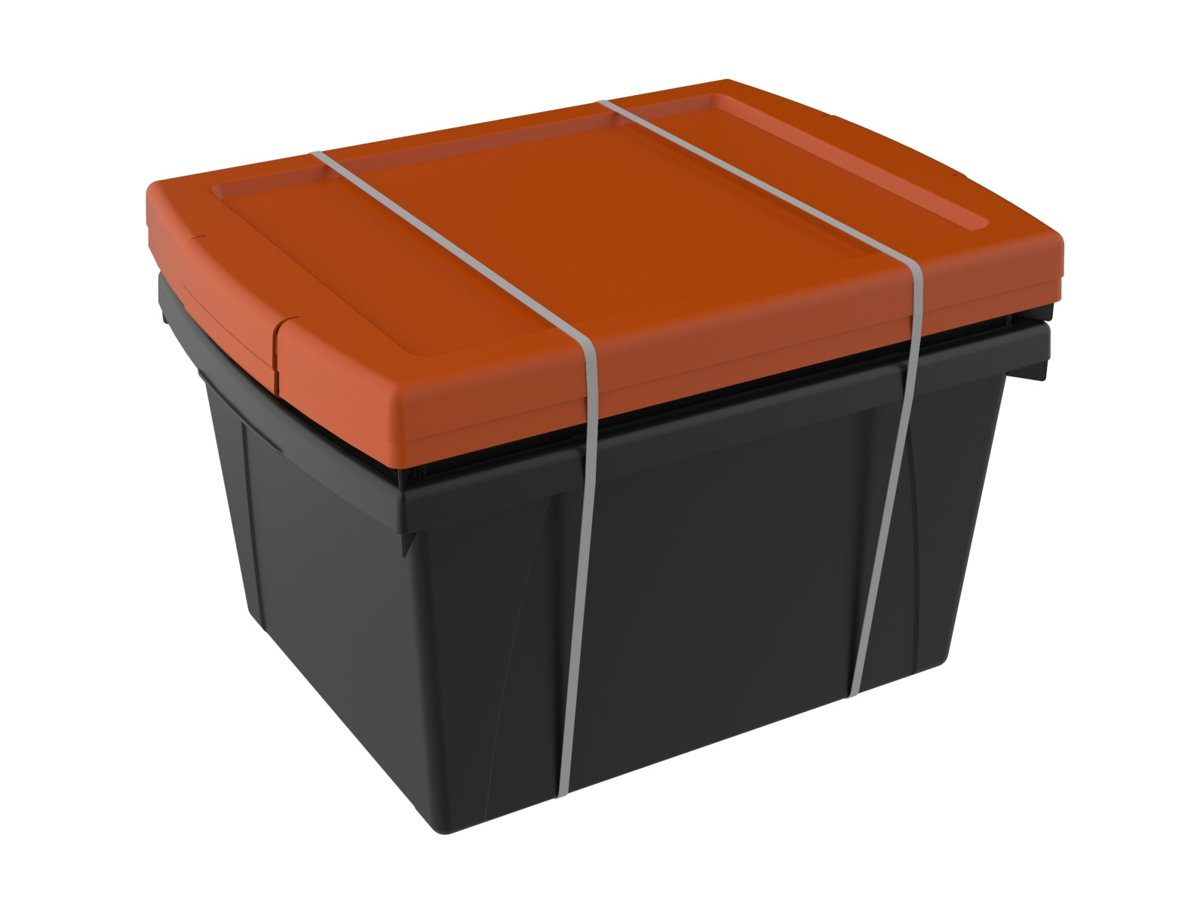
5.5 Gallon Heavy-Duty Plastic Storage Bins
Black – 2 Pack
SAM’S EXCLUSIVE
Features: | DI Cost: | $10.16
Heavy Duty Made of sturdy, drop resistant plastic | Suggested Retail: | $14.99
Organize your supplies | Margin: | 32%
Front and rear handles for easy gripping, even with little hands | Value To Market: | $27.99
Includes clear lid | Savings: | 46%
Why Buy:
Cross sell with legal paper (1 bin conveniently holds up to 4 reams)
Research:
Fluctuating resin prices indirectly created a market opportunity for small, heavy duty storage.
Notes:
8 weeks: July through August
TOTAL: $1.4Mk +125% , next year +30% = $1.82M NEXT YEAR
HOW: Improved front load to prevent OOS, MM PR/marketing, dedicated pallet placement (WITH execution?), improved quality story, less clutter with 4 designs vs 8 LY
LY landed cost: $12.30
Zippers- working with a new supplier to improve the quality without increasing cost.
Inside: lining shredding/cracking- Changing to a non-woven to avoid this in future. Increasing testing prior to avoid.
Straps ripping: Review strap strength and added X stitching below the triangle piece (below) to add additional strength.
Handle/Top – increased load test requirements and handle strength to exceed 95.77ibf

Slide 8
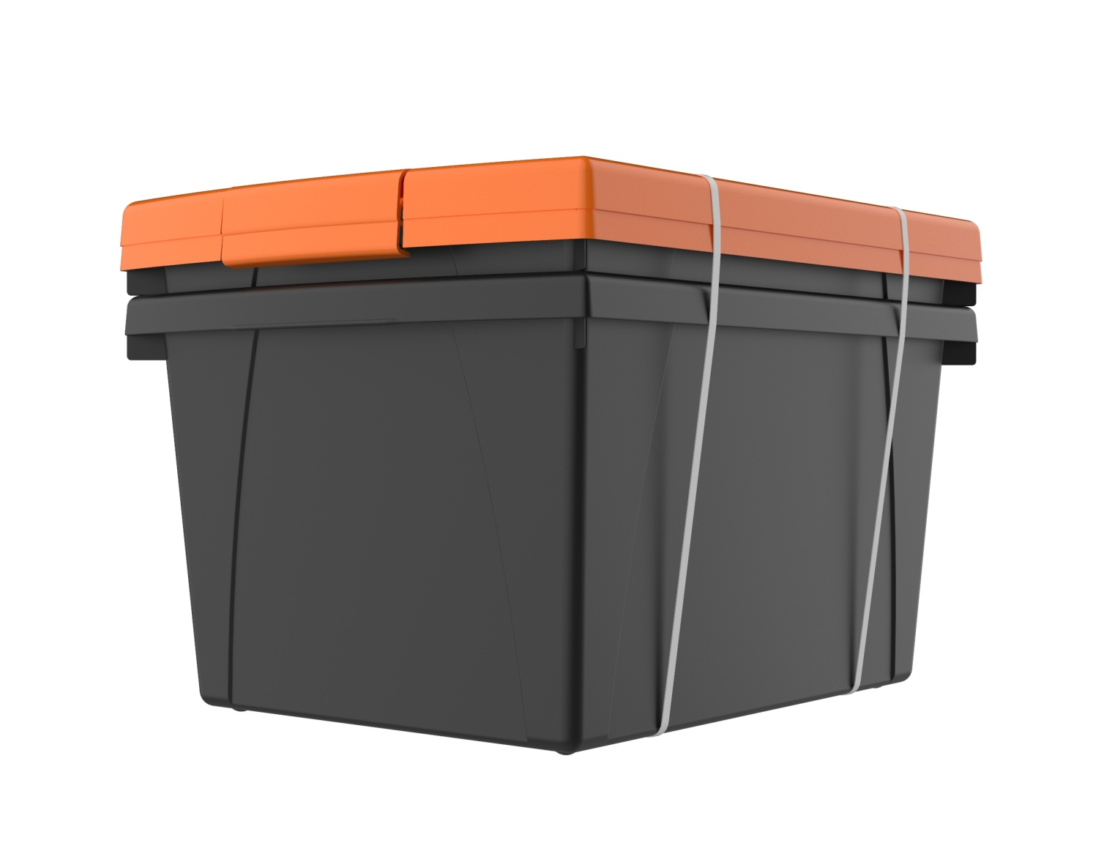
4 Gallon Heavy-Duty Plastic Storage Bins
Black – 2 Pack
SAM’S EXCLUSIVE
Features: | DI Cost: | $7.81
Heavy Duty Made of sturdy, drop resistant plastic | Suggested Retail: | $11.99
Organize your supplies | Margin: | 35%
Front and rear handles for easy gripping, even with little hands | Value To Market: | $22.99
The inside of the bin is 14" long to hold legal and letter size papers and workbooks | Savings: | 48%
Why Buy:
Cross sell with letter paper (1 bin conveniently holds up to 4 reams)
Research:
Fluctuating resin prices indirectly created a market opportunity for small, heavy duty storage.
Notes:
8 weeks: July through August
TOTAL: $1.4Mk +125% , next year +30% = $1.82M NEXT YEAR
HOW: Improved front load to prevent OOS, MM PR/marketing, dedicated pallet placement (WITH execution?), improved quality story, less clutter with 4 designs vs 8 LY
LY landed cost: $12.30
Zippers- working with a new supplier to improve the quality without increasing cost.
Inside: lining shredding/cracking- Changing to a non-woven to avoid this in future. Increasing testing prior to avoid.
Straps ripping: Review strap strength and added X stitching below the triangle piece (below) to add additional strength.
Handle/Top – increased load test requirements and handle strength to exceed 95.77ibf

Slide 9
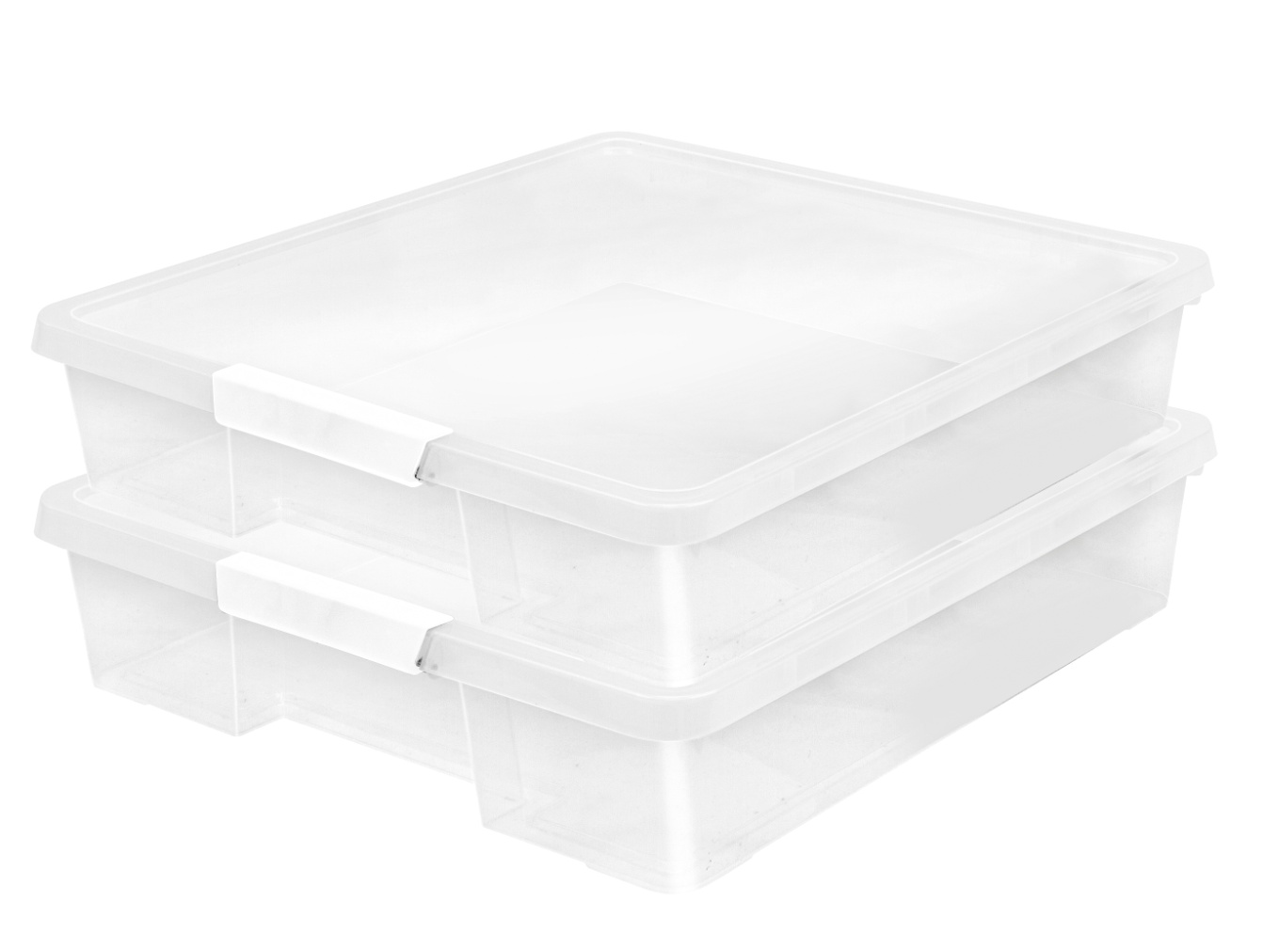
Craft Box – 2 Pack
SAM’S EXCLUSIVE
Features: | Cost: | $6.53
Organize your supplies | Suggested Retail: | $9.99
Made of sturdy, drop resistant plastic | Margin: | 35%
Front and rear handles for easy gripping, even with little hands | Value To Market: | $15.98
The inside of the bin is 14" long to hold legal and letter size papers and workbooks | Savings: | 37%
Why Buy:
Essential craft storage Sold as pack 2 to increase average unit retail
Research:
Perpetual bestseller in the craft space Strong cross seller with paper and activity kits
Notes:
8 weeks: July through August
TOTAL: $1.4Mk +125% , next year +30% = $1.82M NEXT YEAR
HOW: Improved front load to prevent OOS, MM PR/marketing, dedicated pallet placement (WITH execution?), improved quality story, less clutter with 4 designs vs 8 LY
LY landed cost: $12.30
Zippers- working with a new supplier to improve the quality without increasing cost.
Inside: lining shredding/cracking- Changing to a non-woven to avoid this in future. Increasing testing prior to avoid.
Straps ripping: Review strap strength and added X stitching below the triangle piece (below) to add additional strength.
Handle/Top – increased load test requirements and handle strength to exceed 95.77ibf

Slide 10
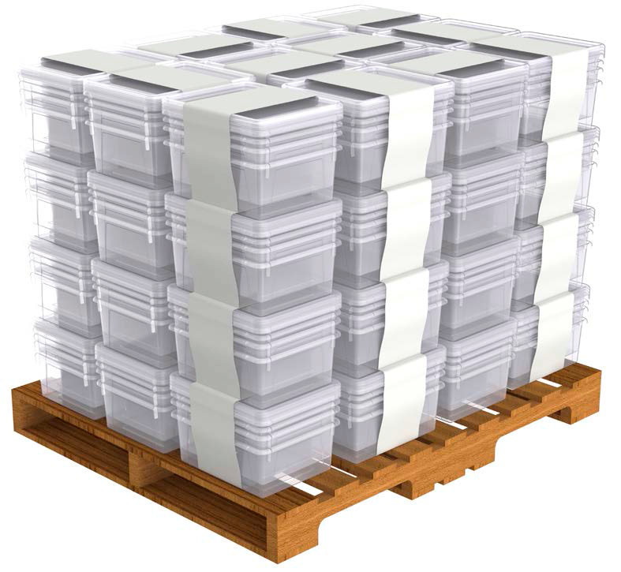
Modular Paper Storage Trays – 4 Pack
SAM’S EXCLUSIVE
Features: | Cost: | $12.56
Set of 2 Deep Trays & 2 Shallow Trays with Lids | Suggested Retail: | $18.99
Fits standard letter size paper, handouts and workbooks | Margin: | 34%
Used to quickly sort and organize cluttered workspaces | Value To Market: | $29.99
Clear bins are the fastest growing item for 2021 | Savings: | 37%
Why Buy:
The space efficiency of a nested assortment gets passed along to consumers Sam's club exclusive assortment of top trending items
Research:
Crystal clear bins are perceived as premium storage Clear storage is mandated by certain industries for safety reasons
Notes:
8 weeks: July through August
TOTAL: $1.4Mk +125% , next year +30% = $1.82M NEXT YEAR
HOW: Improved front load to prevent OOS, MM PR/marketing, dedicated pallet placement (WITH execution?), improved quality story, less clutter with 4 designs vs 8 LY
LY landed cost: $12.30
Zippers- working with a new supplier to improve the quality without increasing cost.
Inside: lining shredding/cracking- Changing to a non-woven to avoid this in future. Increasing testing prior to avoid.
Straps ripping: Review strap strength and added X stitching below the triangle piece (below) to add additional strength.
Handle/Top – increased load test requirements and handle strength to exceed 95.77ibf

