Slide 1
2024
COSTCO PRODUCT OPPORTUNITIES

Slide 2
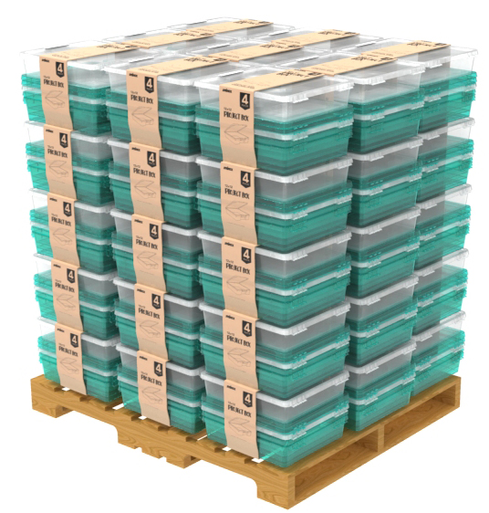
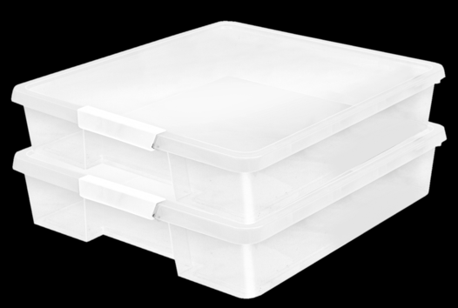
12 X 12 Craft Box
Set of 4
This is the perfect bin to hold each students’ projects and crafts. Use it to hold works in progress including all of your supplies, pens, pencils, crayons, glue, and construction paper. It also fits scrapbooking paper. It is transparent so you can easily see the contents and organize your classroom and all of your supplies
FITS 12 X 12 SCRAPBOOKING PAPER
TRANSPARENT SO YOU CAN EASILY SEE THE CONTENTS
LOCKING LATCH HOLDS THE BOX CLOSED
INTEGRATED HANDLES
Item Name | SKU | Color | Length | Width | Height | Case QTY | Club Price | MSRP
Craft Box | XX | Clear | 13.2’’ | 15.2’’ | 3.2’’ | 4 | $0.00 | $0.00

Slide 3
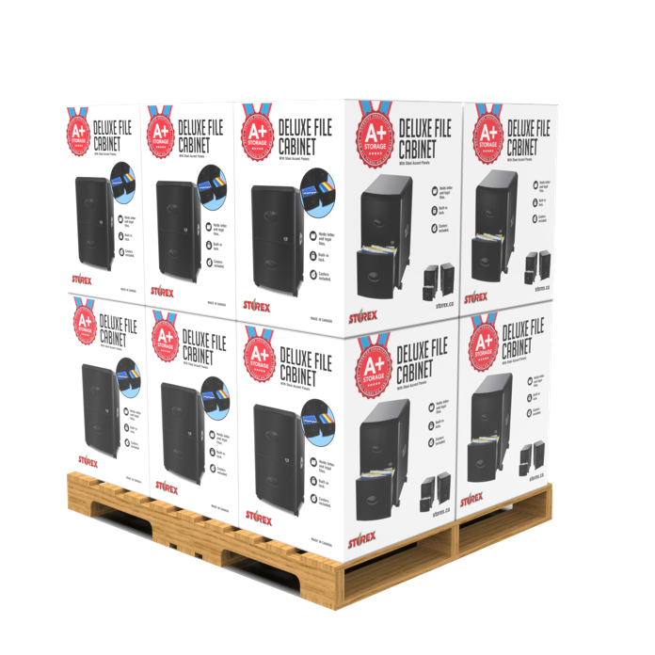
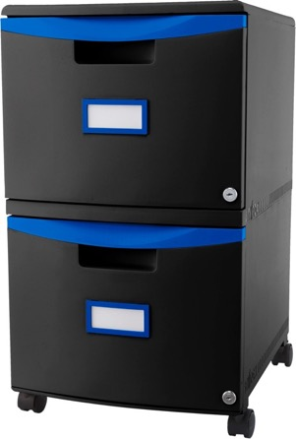
Mobile File Cabinet
Functional and lightweight, the Filing Drawer is the perfect storage solution for those in need of professional and affordable filing. The durable polypropylene construction allows this cabinet to be stackable as well as moisture and rust resistant.
TOP CAN SUPPORT THE WEIGHT OF A STANDARD HOME/OFFICE PRINTER
WON’T SCRATCH, RUST OR DENT
INDEPENDENTLY LOCKABLE DRAWERS
LOCKING CASTERS
BUILT IN LABEL HOLDER
Item Name | SKU | Color | Length | Width | Height | Case QTY | Club Price | MSRP
Mobile File Cabinet | XX | XX | 12’’ | 15’’ | 25’’ | 1 | $0.00 | $0.00

Slide 4
Wiggle Stool
Featuring an adjustable seat height of 12-18" in 2" increments, these wiggle stools grow with your students and eliminate guesswork when ordering. An extra-thick padded seat allows for comfortable all-day use. The tamper-proof adjustable height reduces distractions and help promote a focused environment. The rubberized non-skid base is angled for improved posture and provides stability, even when over-tipped.
SOFT, EXTRA CUSHION PROVIDES COMFORT & SUPPORT FOR ALL-DAY USE
INTEGRATED HANDLES FOR EASY CARRYING, EVEN FOR SMALLER CHILDREN
ADJUSTABLE SEAT HEIGHT BETWEEN 12’’ & 18’’
TAMPER-PROOF HEIGHT ADJUSTMENTS TO PREVENT DISTRACTIONS
ANGLED BASE FOR IMPROVED POSTURE, BALANCE & STABILITY
RUBBERIZED, NON-SLIP BASE FOR INCREASED STABILITY, EVEN WHEN OVER-TIPPED
Item Name | SKU | Color | Length | Width | Height | Case QTY | Club Price | MSRP
Wiggle Stool | 00303U01C | Teal | 13’’ | 13’’ | 12-18’’ | 1 | $0.00 | $0.00

Slide 5
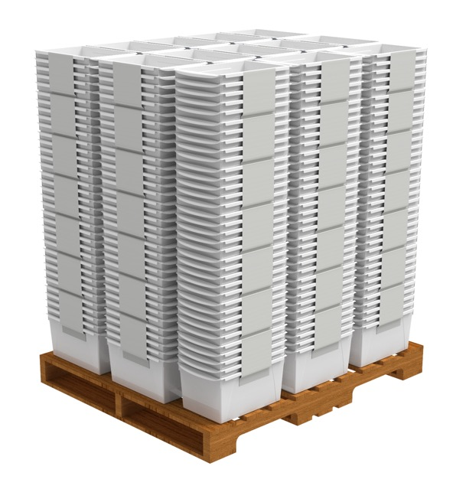
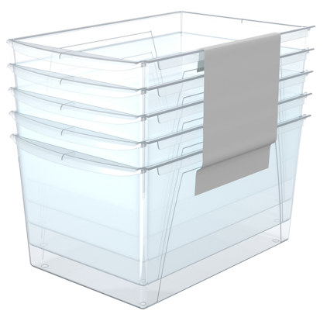
Wide Book Bin
Set of 5
The Wide Book bins are the most versatile bins. Use them on 15’’ deep shelves and desktops or turn them sideways to fit into narrow 12’’ shelves and bookcases. They fit scrapbook paper, letter sized files and folder, and large magazines. Interior depth is 14’’. They also feature the bright colors and integrated carry handles. Label pouches not included. Bright colors are ideal for STEM or STEAM organization.
FITS SCRAPBOOK PAPER, LETTER SIZED FILES AND FOLDER
LINK SEVERAL BINS TOGETHER FOR STABILITY
TURN THEM SIDEWAYS TO FIT IN 12’’ BOOKCASES
INTEGRATED CARRY HANDLES
FITS 15’’ DEEP SHELVES
Item Name | SKU | Color | Length | Width | Height | Case QTY | Club Price | MSRP
Wide Book Bin | TBC | Clear | 14.5’’ | 9.2’’ | 7’’ | 5 | $0.00 | $0.00

Slide 6
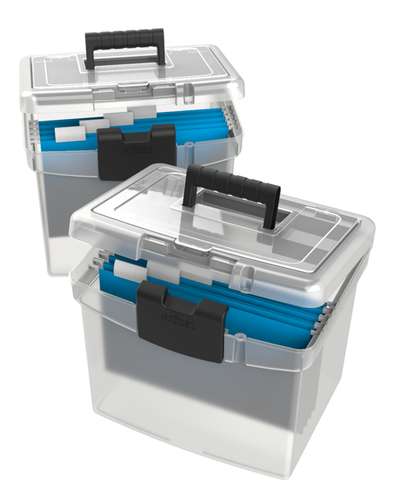
Portable File Box XL
The new File Storage Box from Storex has and extra large storage lid for all of your supplies. It holds 5% more hanging letter files and folders than our old box. It features a clamping latch which shuts the lid safely and, for added security, it also accepts a padlock.
HOLDS LETTER SIZED HANGING FILE FOLDERS
EXTRA LARGE COMPARTMENT IN LID
IMPACT RESISTANT PLASTIC
HOLDS UP TO 30 LBS
INCLUDES AN EASY GRIP HANDLE
Item Name | SKU | Color | Length | Width | Height | Case QTY | Club Price | MSRP
Portable File Box | TBC | Clear | 14.5’’ | 10.9’’ | 13.2’’ | 1 | $0.00 | $0.00

Slide 7
Portable File Box
With Drawer
The new File Storage Box from Storex has and extra large storage drawer for all of your supplies. It holds 5% more hanging letter files and folders than our old box. It features a clamping latch which shuts the lid safely and, for added security, it also accepts a padlock.
HOLDS LETTER SIZED HANGING FILE FOLDERS
BOTTOM DRAWER TO KEEPS SUPPLIES
MOISTURE RESISTANT
HOLDS UP TO 30 LBS
INCLUDES AN EASY GRIP HANDLE
Item Name | SKU | Color | Length | Width | Height | Case QTY | Club Price | MSRP
Portable File Box & Drawer | TBC | Black | 14.2’’ | 11.5’’ | 13’’ | 1 | $0.00 | $0.00

Slide 9
Portable File Box
Transport your files between rooms or workplaces easily with the Letter/Legal File Storage Box. The lightweight polypropylene construction offers a great water-resistant alternative to a banker box. The top compartment with a clear lid conveniently keeps your small supplies visible and accessible. The boxes conveniently hold either letter or legal sized hanging folders using the included insert.
HOLDS LETTER SIZED HANGING FILE FOLDERS
RUBBERRIZED HANDLE FOR EASY GRIP
HOLDS UP TO 30 LBS
Item Name | SKU | Color | Length | Width | Height | Case QTY | Club Price | MSRP
Portable File Box | TBC | Black | 17.1’’ | 9.6’’ | 3.5’’ | 1 | $0.00 | $0.00

Slide 10
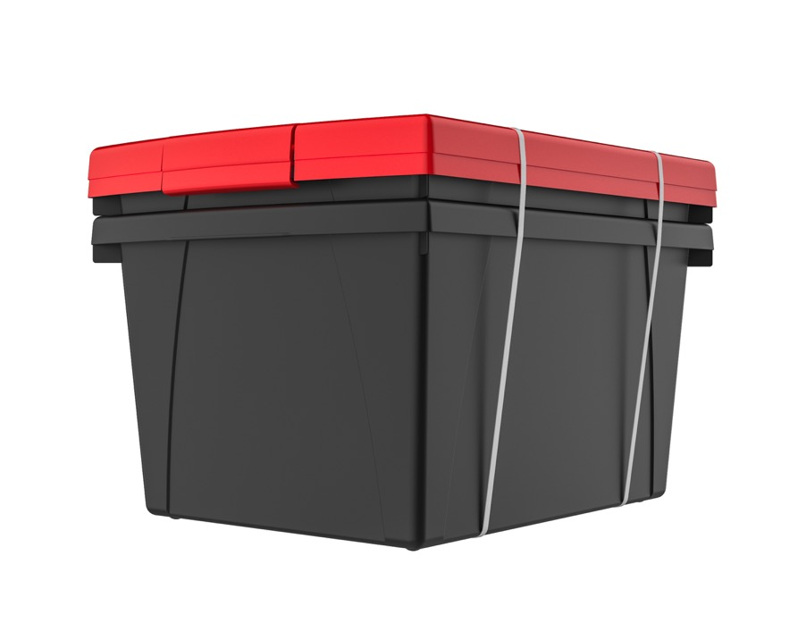
4G. Storage Bin & Lid
These storage bins are the ultimate companion for your bookshelf or cubby. The easy to grip handles are perfectly sized for big and small hands. They are made of impact resistant plastic and come in wonderfully bright colors. Use them to organize your room and store all your supplies. Clear snap on lid is included.
ORGANIZE YOUR SUPPLIES
MADE OF STURDY, DROP RESISTANT PLASTIC
FRONT AND REAR HANDLES FOR EASY GRIPPING
INCLUDES LID
Item Name | SKU | Color | Length | Width | Height | Case QTY | Club Price | MSRP
4G. Storage Bin | TBC | Black/Red | 13.6’’ | 11.3’’ | 8’’ | 6 | $0.00 | $0.00

Slide 11
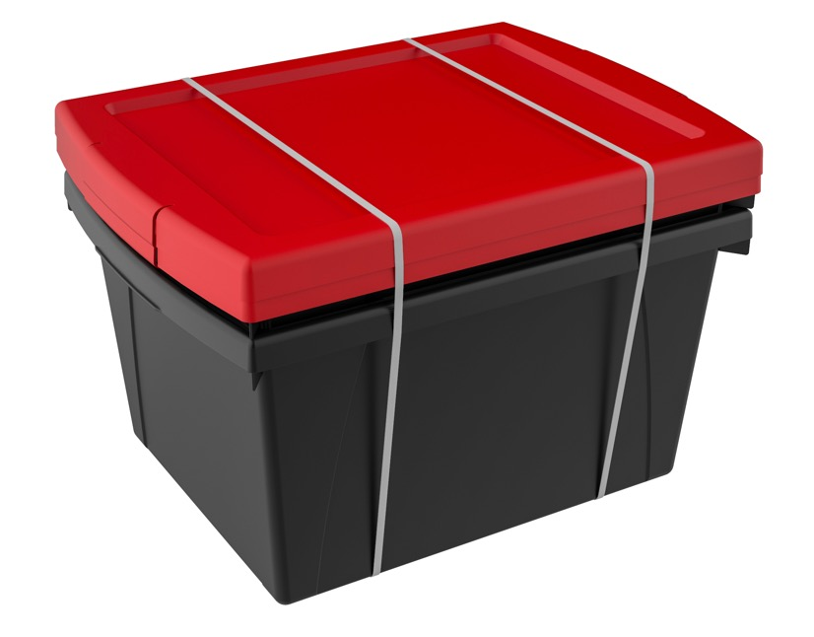
5.5G. Storage Bin & Lid
These storage bins are the ultimate companion for your bookshelf or cubby. The easy to grip handles are perfectly sized for big and small hands. They are made of impact resistant plastic and come in wonderfully bright colors. Use them to organize your room and store all your supplies.
ORGANIZE YOUR SUPPLIES
MADE OF STURDY, DROP RESISTANT PLASTIC
FRONT AND REAR HANDLES FOR EASY GRIPPING
INCLUDES LID
THE INSIDE OF THE BIN IS 14’’ LONG TO HOLD LEGAL AND LETTER SIZE PAPERS AND WORKBOOKS
Item Name | SKU | Color | Length | Width | Height | Case QTY | Club Price | MSRP
5.5G Storage Bin | TBC | Black/Red | 16.8’’ | 11.9’’ | 8.2’’ | 6 | $0.00 | $0.00

Slide 12
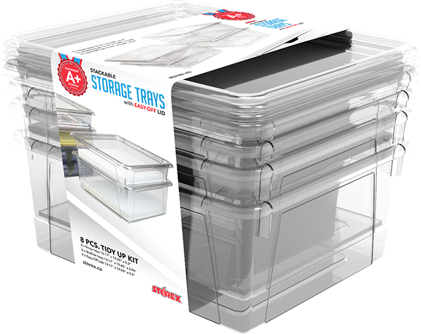
Deep Storage Tray
Set of 4
These storage trays are designed to neatly organize all your letter-sized handouts, booklets and papers. The transparent material lets you easily view its contents with just a glance. The easy-to-grip comfort edges are perfectly sized for big and small hands. Made of nonporous plastic, these trays are dishwasher safe and drop resistant. The included lids make these trays stackable and protect their contents.
FITS STANDARD LETTER SIZE
TRANSPARENT SO YOU CAN EASILY SEE CONTENTS
MADE OF STURDY, DROP RESISTANT PLASTIC
NONPOROUS MATERIAL WIPES CLEAN & IS DISHWASHER SAFE
Item Name | SKU | Color | Length | Width | Height | Case QTY | Club Price | MSRP
Deep Storage Tray | TBC | Clear | 13.2’’ | 10.6’’ | 5.2’’ | 4 | $0.00 | $0.00

Slide 13
 |  |  | BLADE DIMENSIONS
Item Name | SKU | Color | Length | Width | Height | Case QTY | Club Price | MSRP
15’’ Polytuff | TBD | Clear Blue | 13’’ | 15’’ | 54’’ | 118 | $0.00 | $0.00
20’’ Polytuff | 6576889 | Clear Blue | 13’’ | 20’’ | 54’’ | 89 | $0.00 | $0.00
24’’ Polytuff | 1001427 | Clear Blue | 13’’ | 24’’ | 54’’ | 76 | $0.00 | $0.00

Slide 14
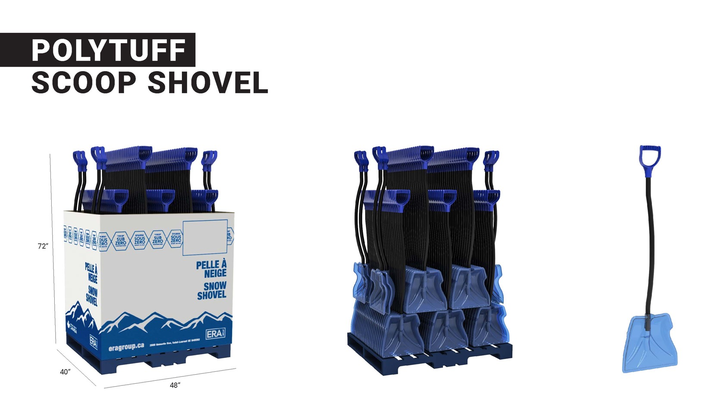
 |  |  | BLADE DIMENSIONS
Item Name | SKU | Color | Length | Width | Height | Case QTY | Club Price | MSRP
15’’ Polytuff | TBD | Clear Blue | 13’’ | 15’’ | 54’’ | 118 | $0.00 | $0.00

Slide 15
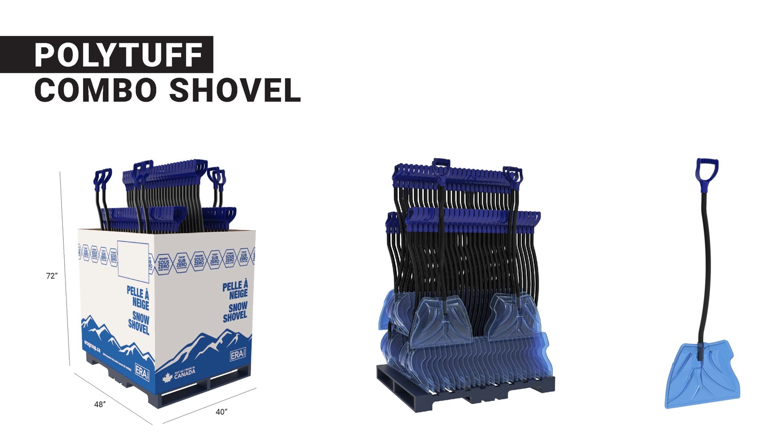
 |  |  | BLADE DIMENSIONS
Item Name | SKU | Color | Length | Width | Height | Case QTY | Club Price | MSRP
20’’ Polytuff | 6576889 | Clear Blue | 13’’ | 20’’ | 54’’ | 89 | $0.00 | $0.00

Slide 16
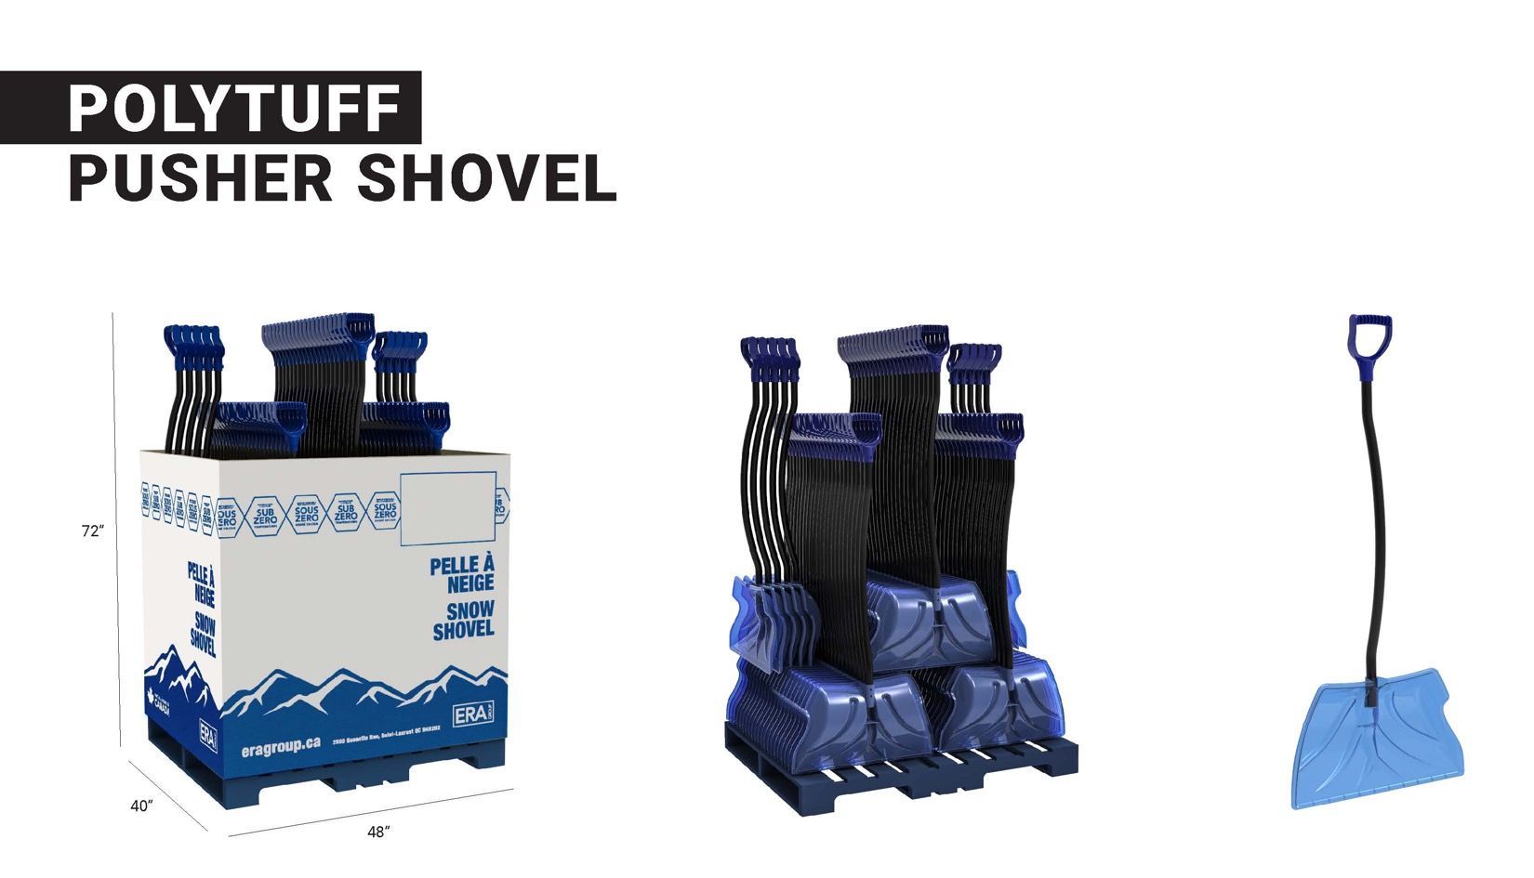
 |  |  | BLADE DIMENSIONS
Item Name | SKU | Color | Length | Width | Height | Case QTY | Club Price | MSRP
24’’ Polytuff | 1001427 | Clear Blue | 13’’ | 24’’ | 54’’ | 76 | $0.00 | $0.00

Slide 17
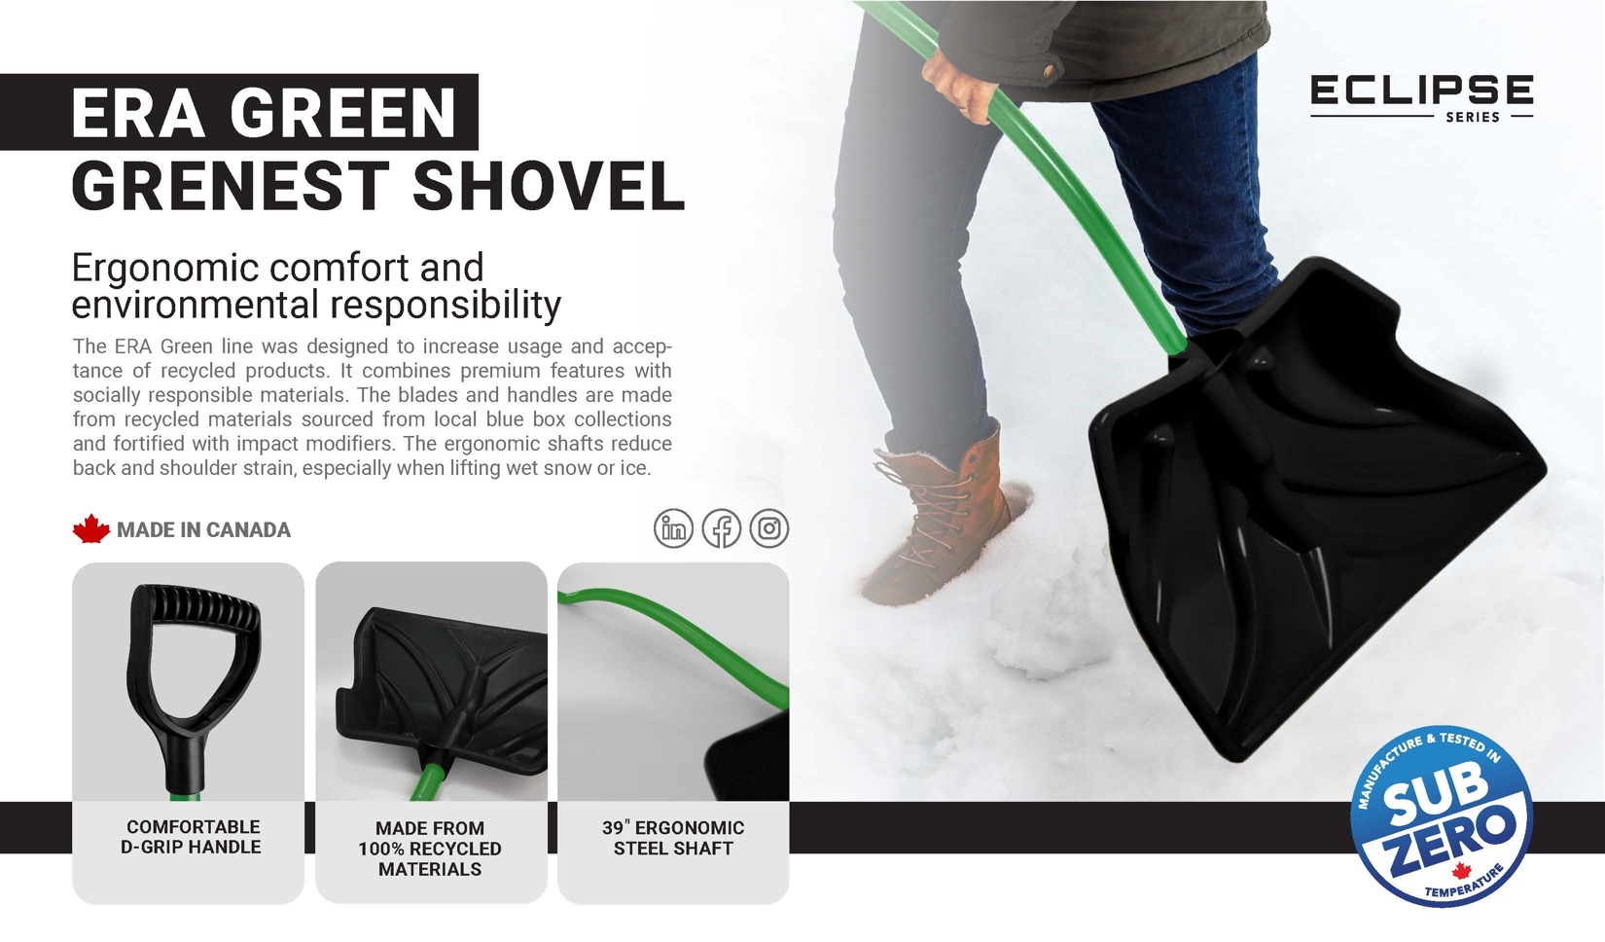
 |  |  | BLADE DIMENSIONS
Item Name | SKU | Color | Length | Width | Height | Case QTY | Club Price | MSRP
15’’ Era Green | 2000157 | Black/Green | 13’’ | 15’’ | 54’’ | 118 | $0.00 | $0.00
20’’ Era Green | 2000158 | Black/Green | 13’’ | 20’’ | 54’’ | 89 | $0.00 | $0.00
24’’ Era Green | 2000160 | Black/Green | 13’’ | 24’’ | 54’’ | 76 | $0.00 | $0.00

Slide 18
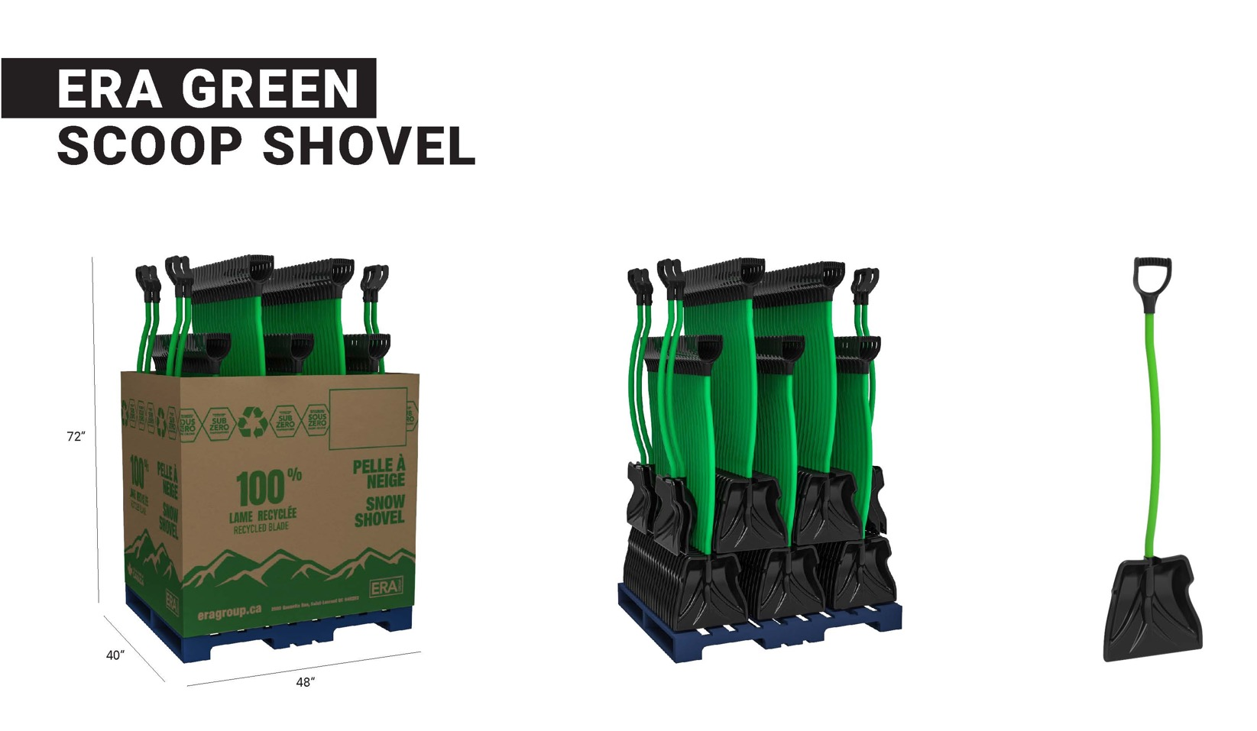
 |  |  | BLADE DIMENSIONS
Item Name | SKU | Color | Length | Width | Height | Case QTY | Club Price | MSRP
15’’ Era Green | 2000157 | Black/Green | 13’’ | 15’’ | 54’’ | 118 | $0.00 | $0.00

Slide 19
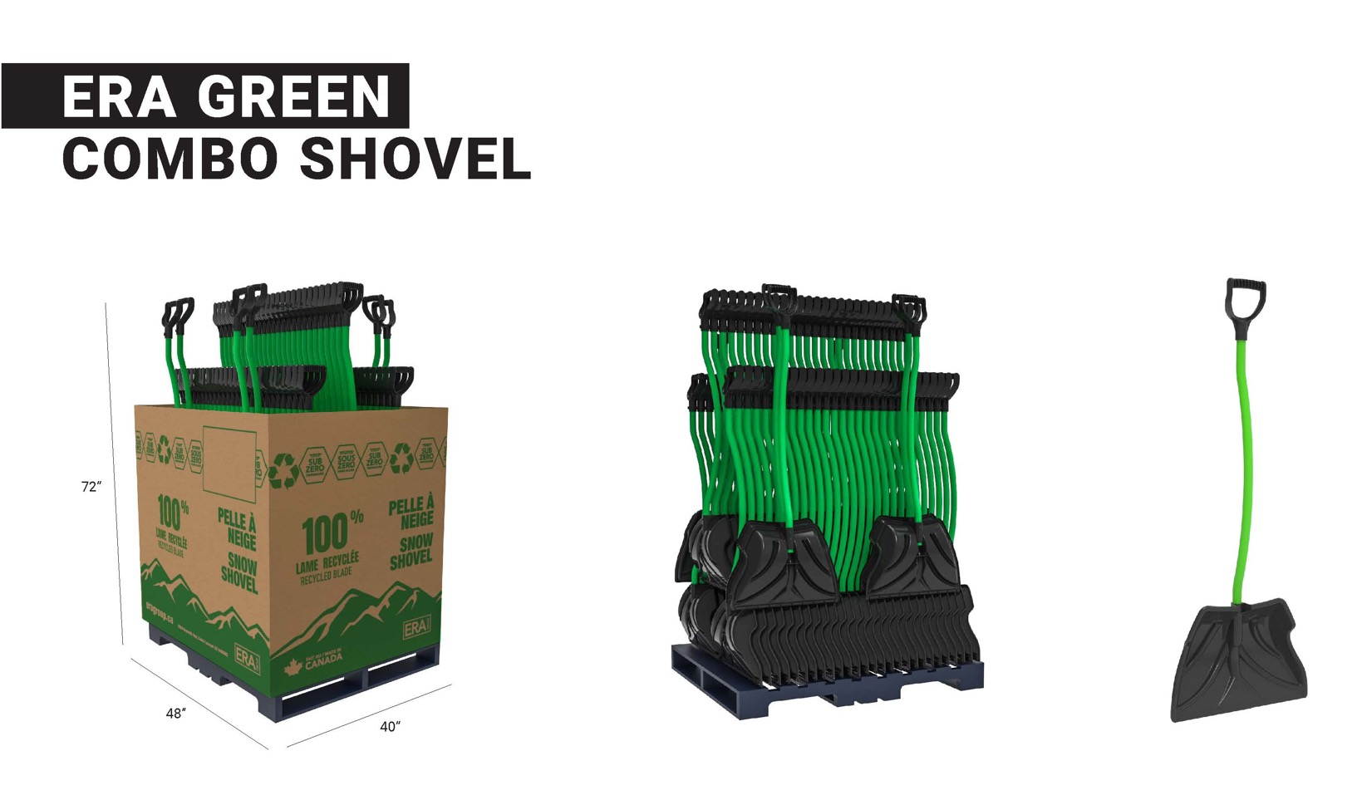
 |  |  | BLADE DIMENSIONS
Item Name | SKU | Color | Length | Width | Height | Case QTY | Club Price | MSRP
20’’ Era Green | 2000158 | Black/Green | 13’’ | 20’’ | 54’’ | 89 | $0.00 | $0.00

Slide 20
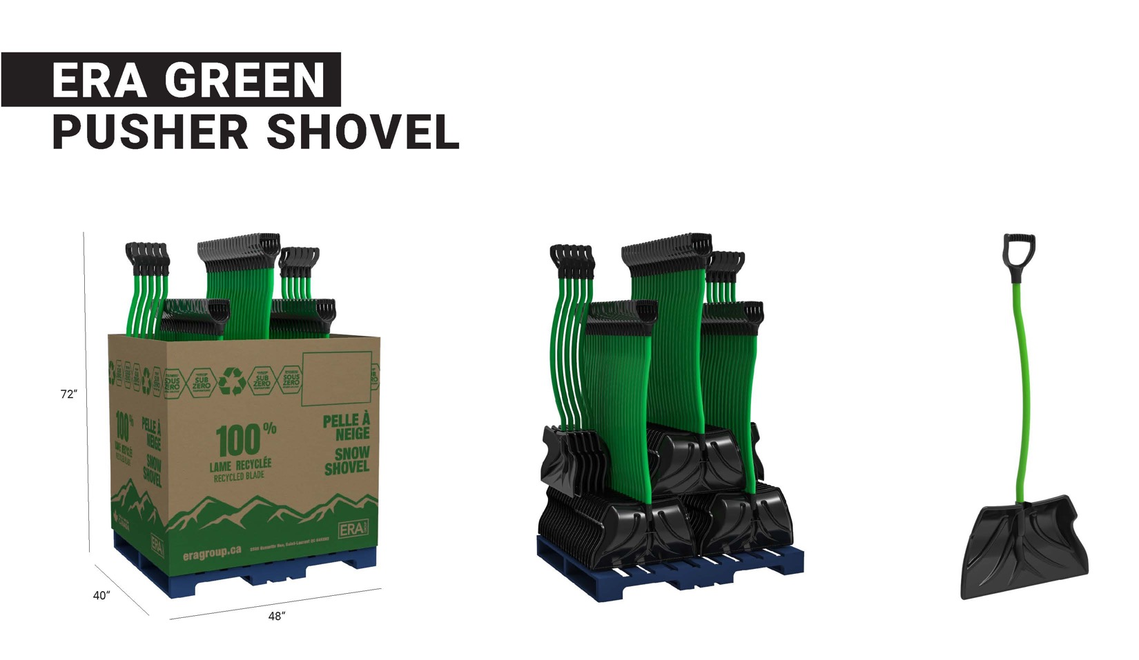
 |  |  | BLADE DIMENSIONS
Item Name | SKU | Color | Length | Width | Height | Case QTY | Club Price | MSRP
24’’ Era Green | 2000160 | Black/Green | 13’’ | 24’’ | 54’’ | 76 | $0.00 | $0.00

Slide 21
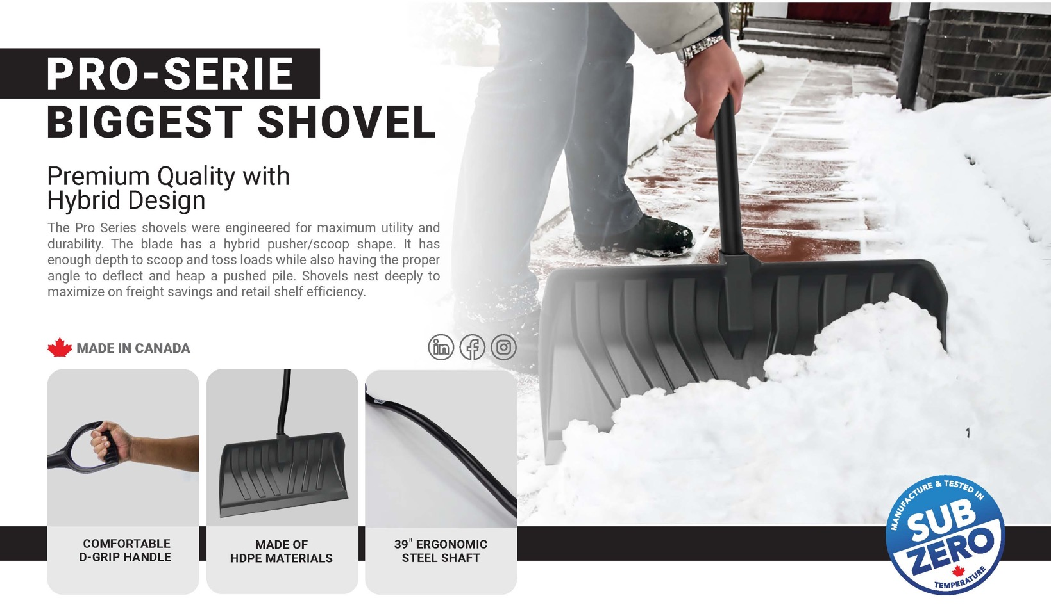
 |  |  |  | BLADE DIMENSIONS
Item Name | SKU | Metal Edge | Color | Length | Width | Height | Case QTY | Club Price | MSRP
24’’ Pro-Serie | TBD | Optional | Grey | 13’’ | 24’’ | 53’’ | 57 | $0.00 | $0.00
28’’ Pro-Serie | TBD | Optional | Grey | 13’’ | 28’’ | 53’ | 62 | $0.00 | $0.00

Slide 22
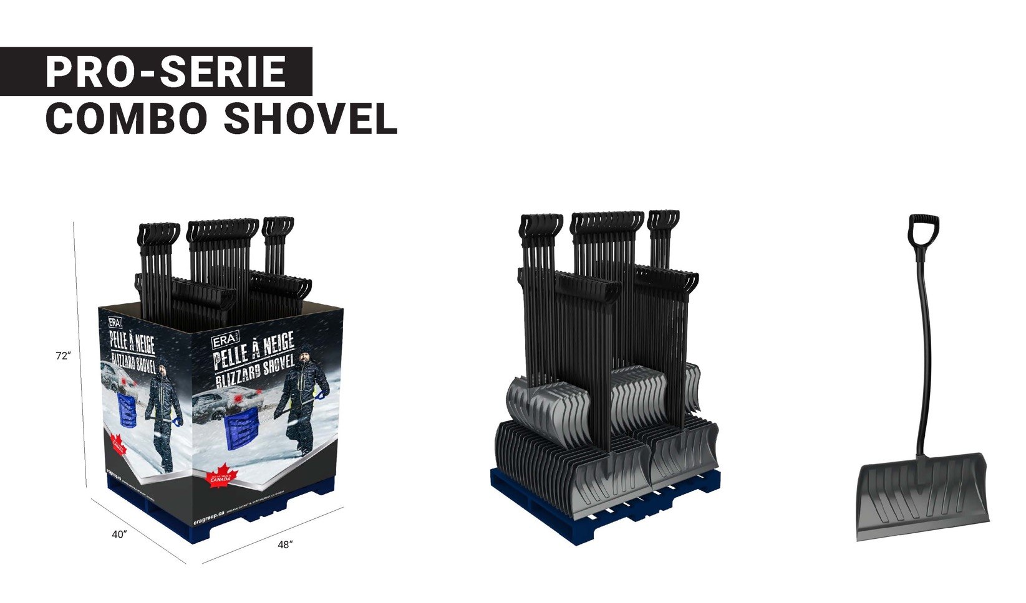
 |  |  |  | BLADE DIMENSIONS
Item Name | SKU | Metal Edge | Color | Length | Width | Height | Case QTY | Club Price | MSRP
24’’ Pro-Serie | TBD | Optional | Grey | 13’’ | 24’’ | 53’’ | 57 | $0.00 | $0.00

Slide 23
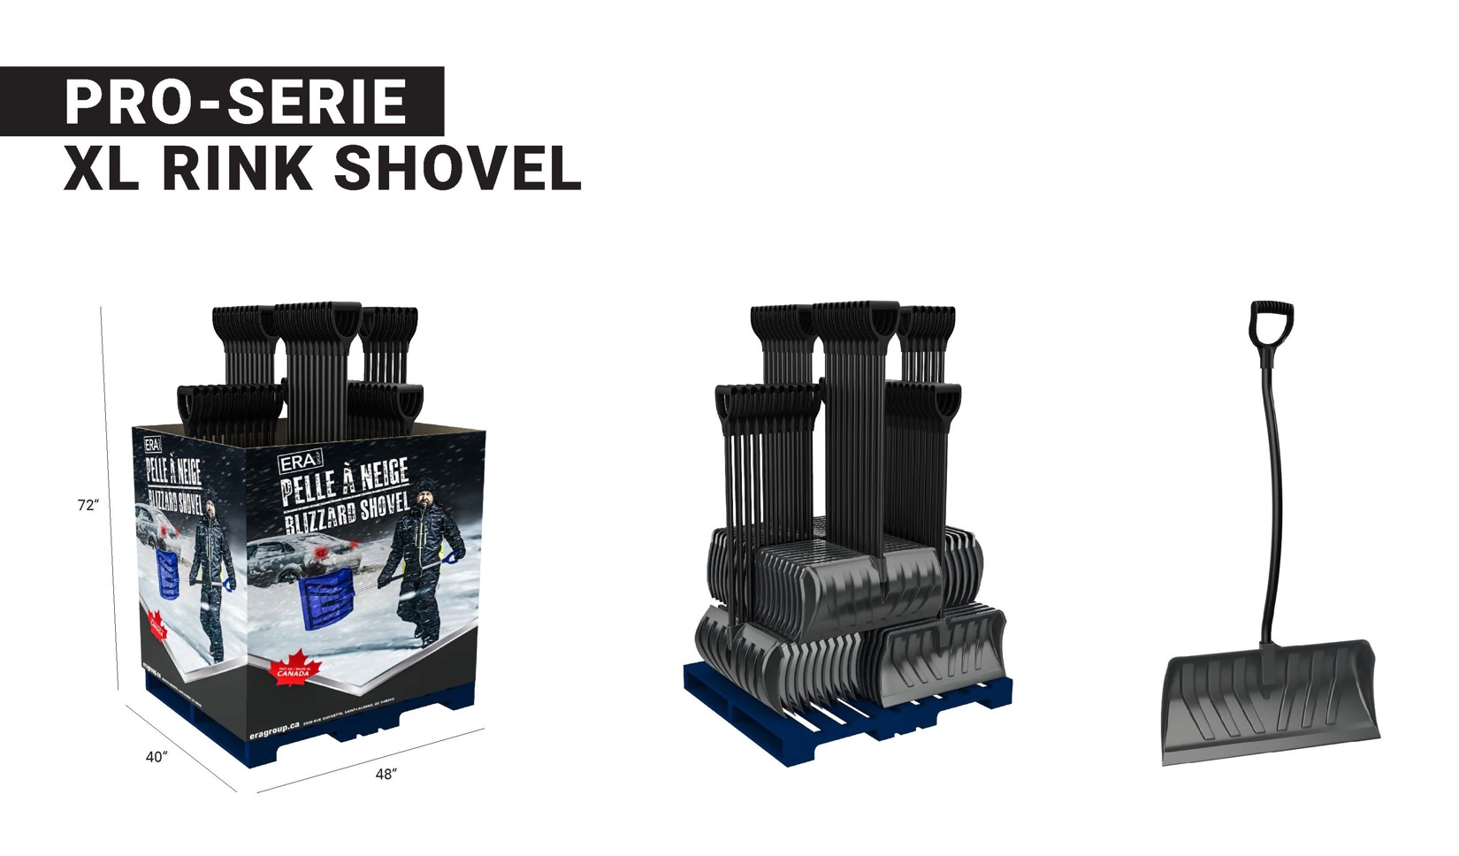
 |  |  |  | BLADE DIMENSIONS
Item Name | SKU | Metal Edge | Color | Length | Width | Height | Case QTY | Club Price | MSRP
28’’ Pro-Serie | TBD | Optional | Grey | 13’’ | 28’’ | 53’ | 62 | $0.00 | $0.00

Slide 24
 |  |  | BLADE DIMENSIONS
Item Name | SKU | Color | Length | Width | Height | Case QTY | Club Price | MSRP
Tuffrake | 2000575 | Grey | 24’’ | 22’’ | 63’’ | 48 | $0.00 | $0.00

Slide 25
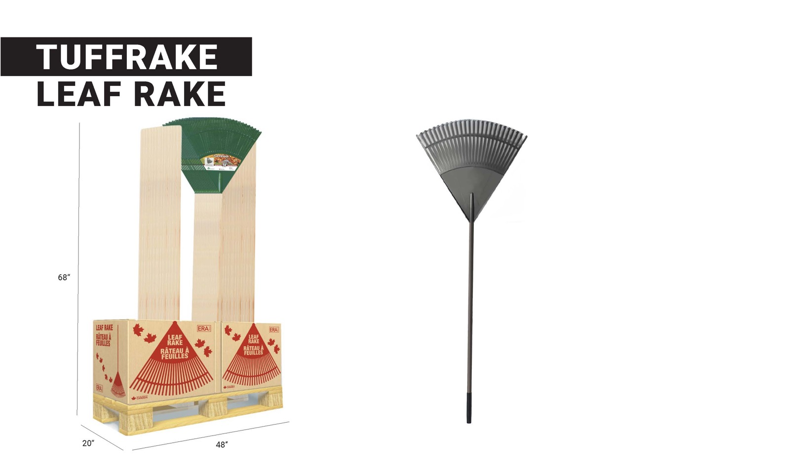
 |  |  | BLADE DIMENSIONS
Item Name | SKU | Color | Length | Width | Height | Case QTY | Club Price | MSRP
Tuffrake | 2000575 | Grey | 24’’ | 22’’ | 63’’ | 48 | $0.00 | $0.00

